Slide 1






















Slide 3















Slide 10
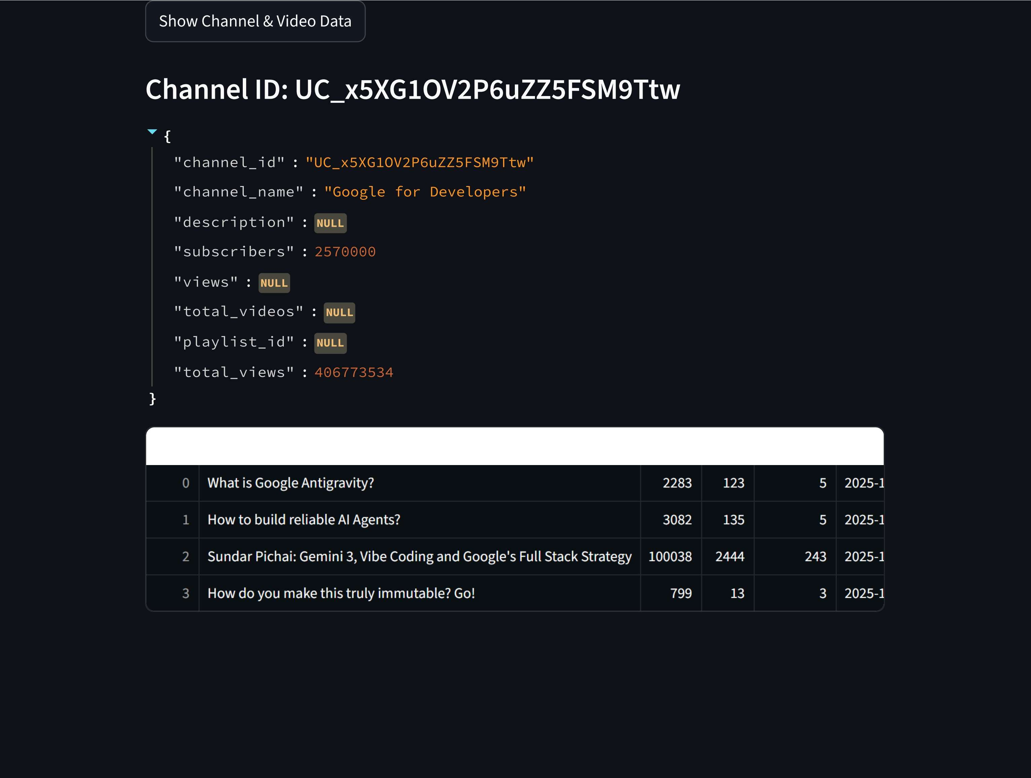





Slide 11
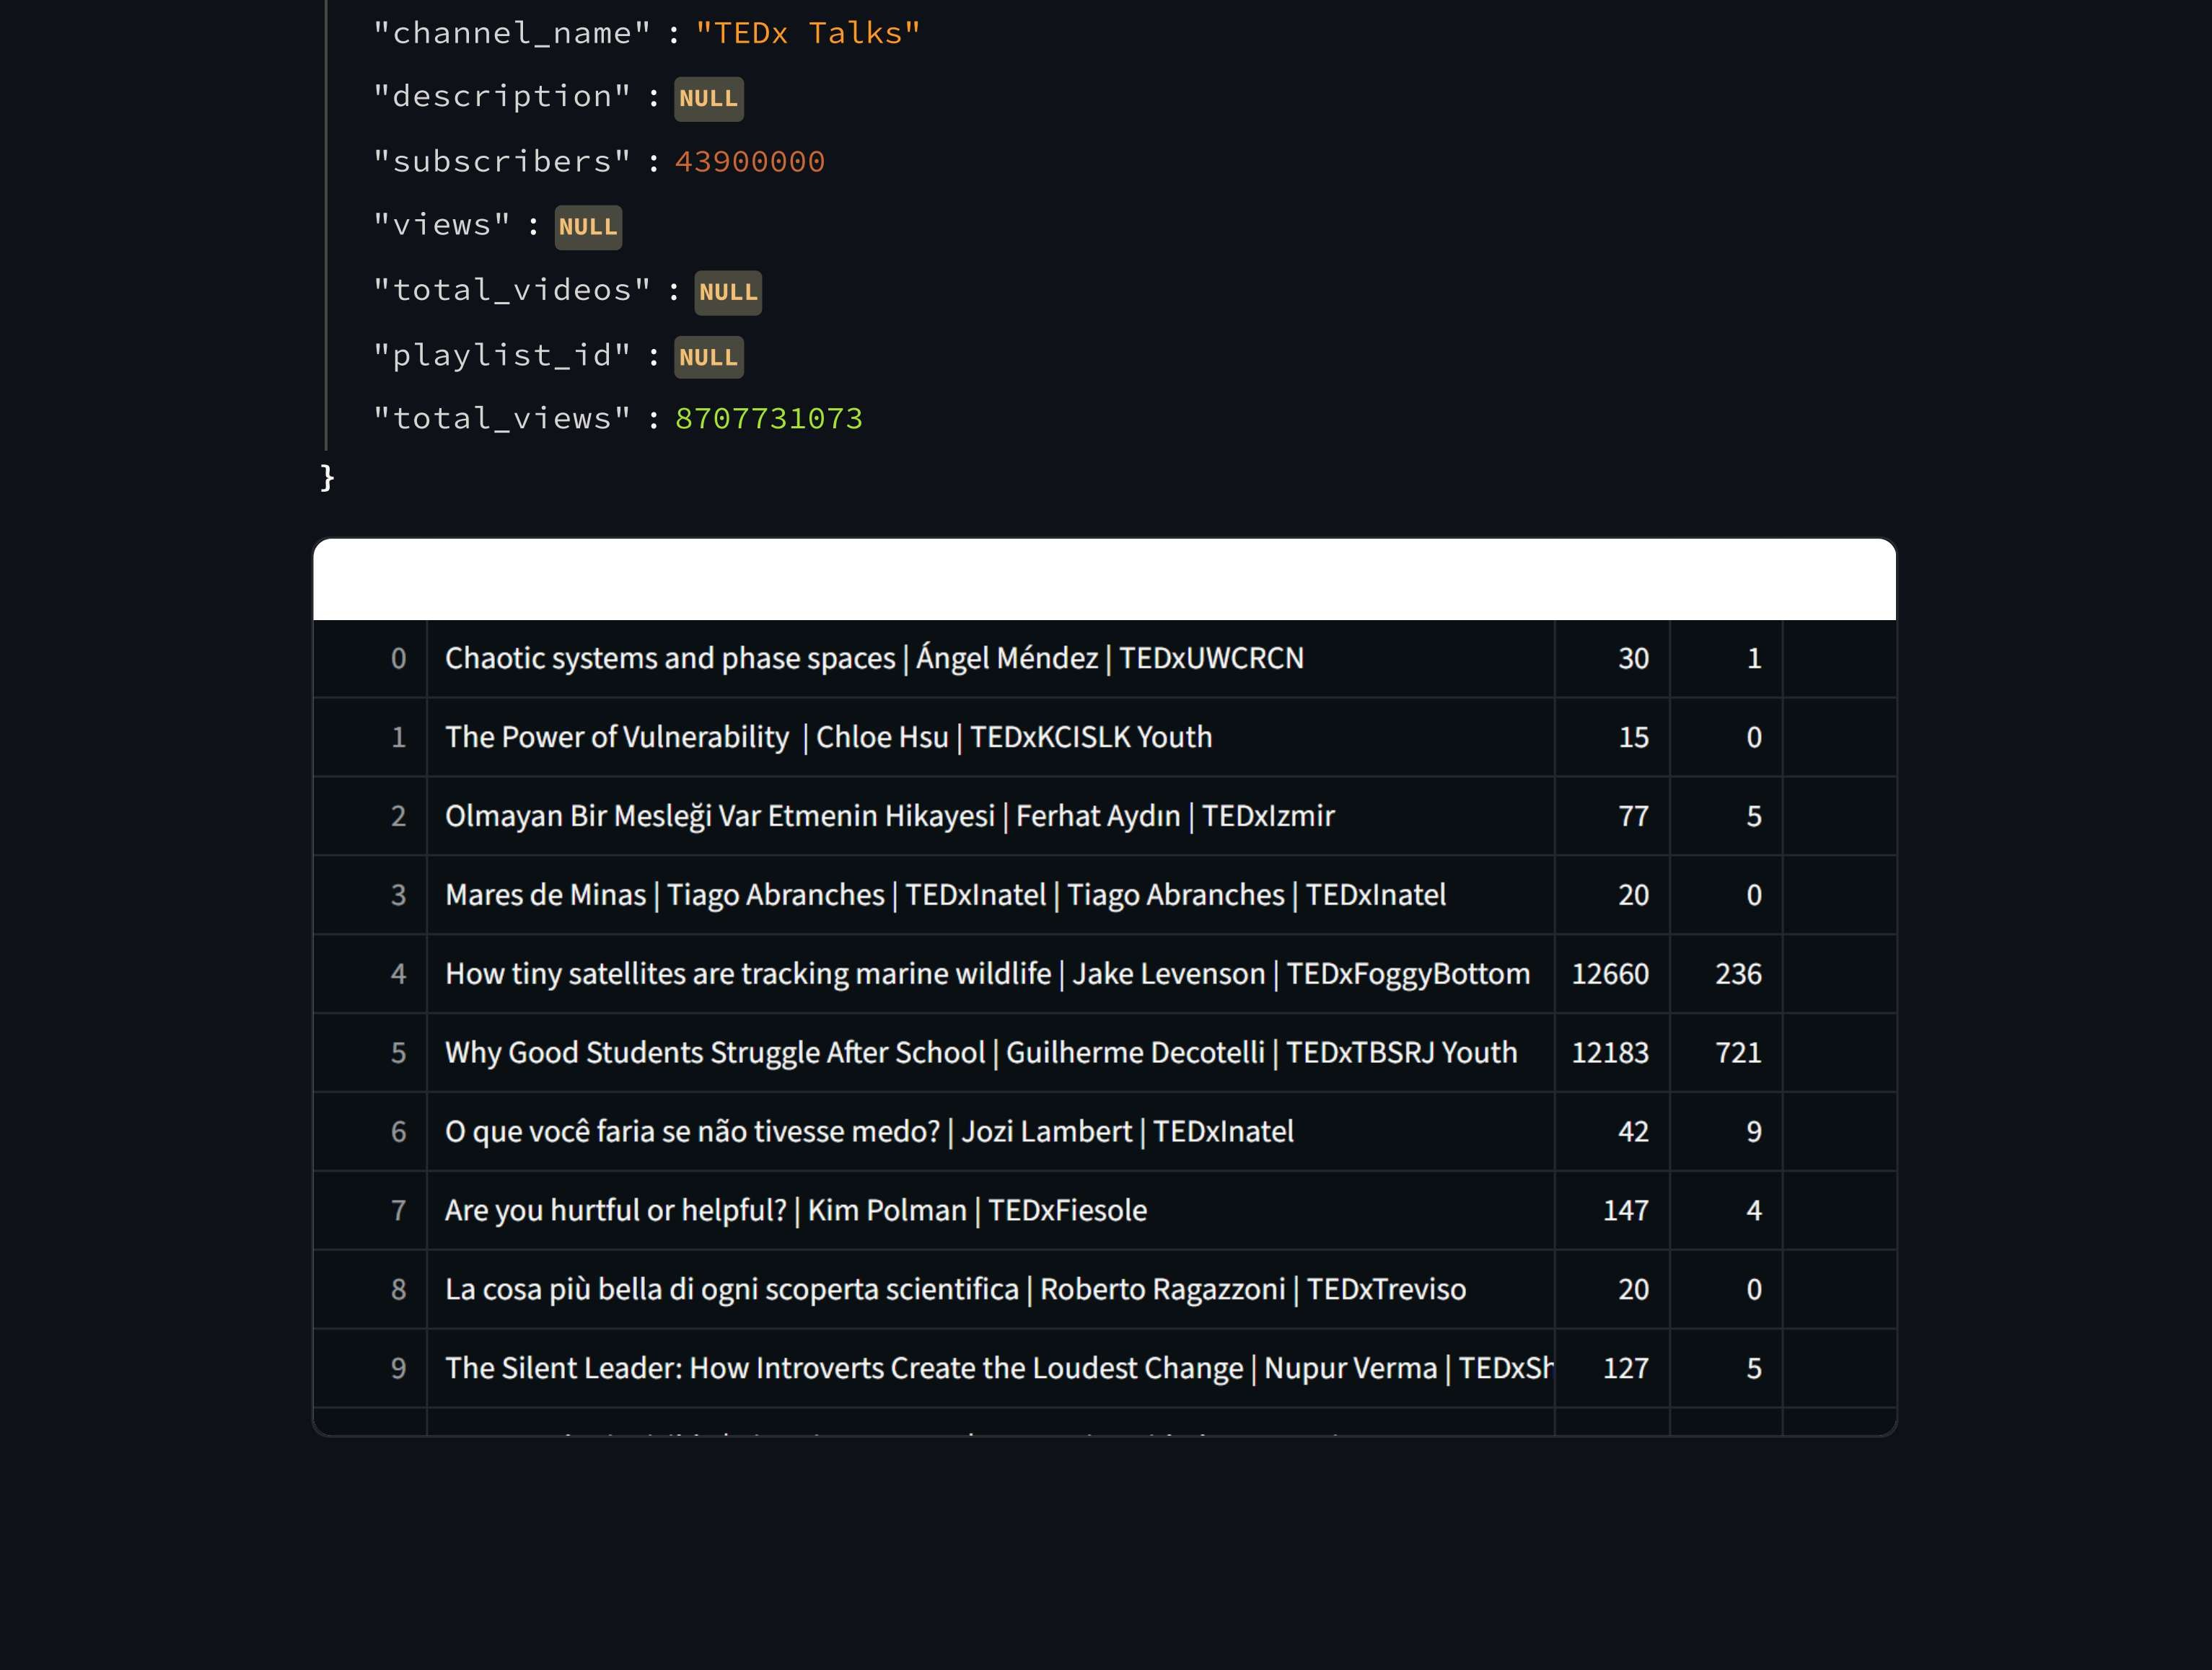



Slide 12
"c h an ne1 _ na me " : " .‹e r ń ta s 1 si‹i"
"d E'S C r á p t 1 o n " : NULL
"s ubs c r ń be r s " :
"v ä ew s " : NULL
"I o t a I _ v á de o s " : NULL
"p 1 a y T J s t _ J d " : NULL
"to I aI v ń ews " : 38385524 14
title views likes comments published at durati
0 The BEST way to tie your shoelaces 5328714 192998 4869 2024—11—16T15:01:57Z 60
I I call this the 'No, You Don't’ Law 43527372 1813479 7856 2024-04-10T17:11:15Z 58
2 Where Do Trees Get Their Mass? 2487267 47515 4884 2012-03-12T14:36:59Z 250
3 Why did light bulb lifetimes get shorter? 6511921 210741 7343 2025-07-17T18:56:42Z 96
4 The most dangerous problem in math 16748470 689926 10723 2024-04-24T15:44:56Z 60
5 How Does A Boomerang Work? 956338 11024 700 2012-08-17T10:46:58Z 174
How Trees Bend the Laws of Physics 4940893 15T823 8074 2012-10-30T13:00:52Z 443
7 Can you solve the prisoner's riddle? 7707428 212837 2936 2025-03-24T15:46:32Z 102
S What happens if you cut the green rope? 840880 18017 474 2025-07-11T12:52:59Z 104
0 What Is The Coastline Paradox? 1837215 30452 2249 2012-01-07T02:55:10Z 136

Slide 13







Slide 14
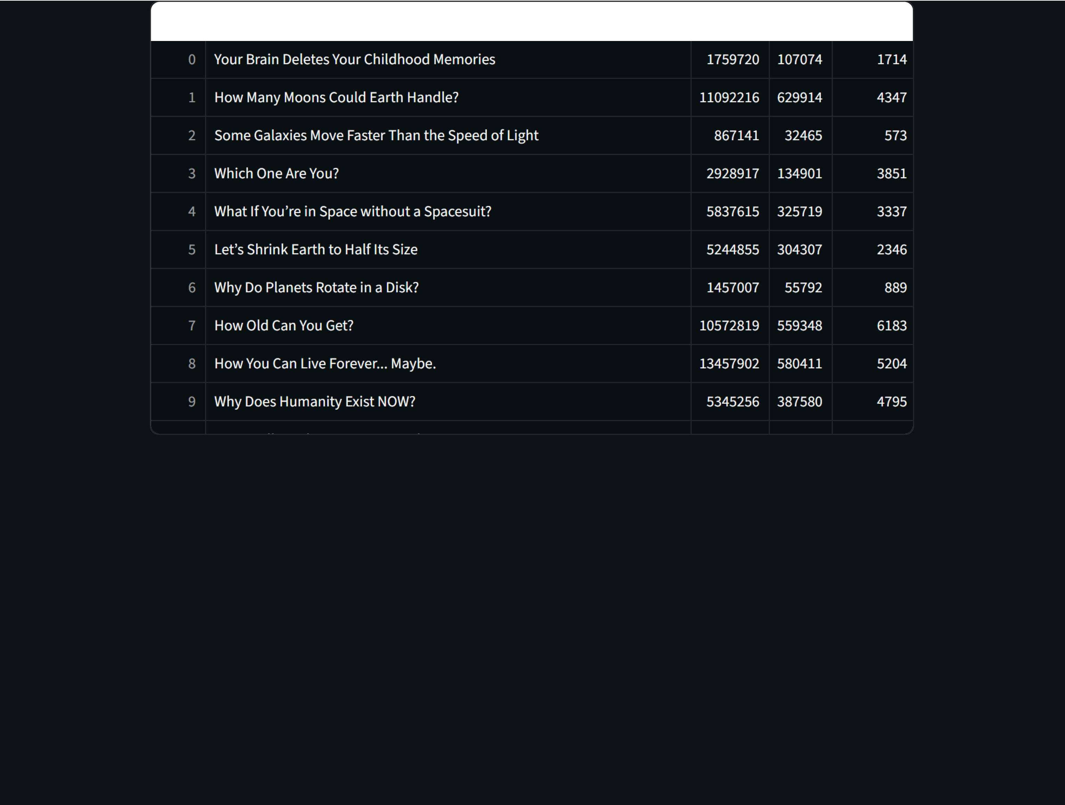







Slide 15
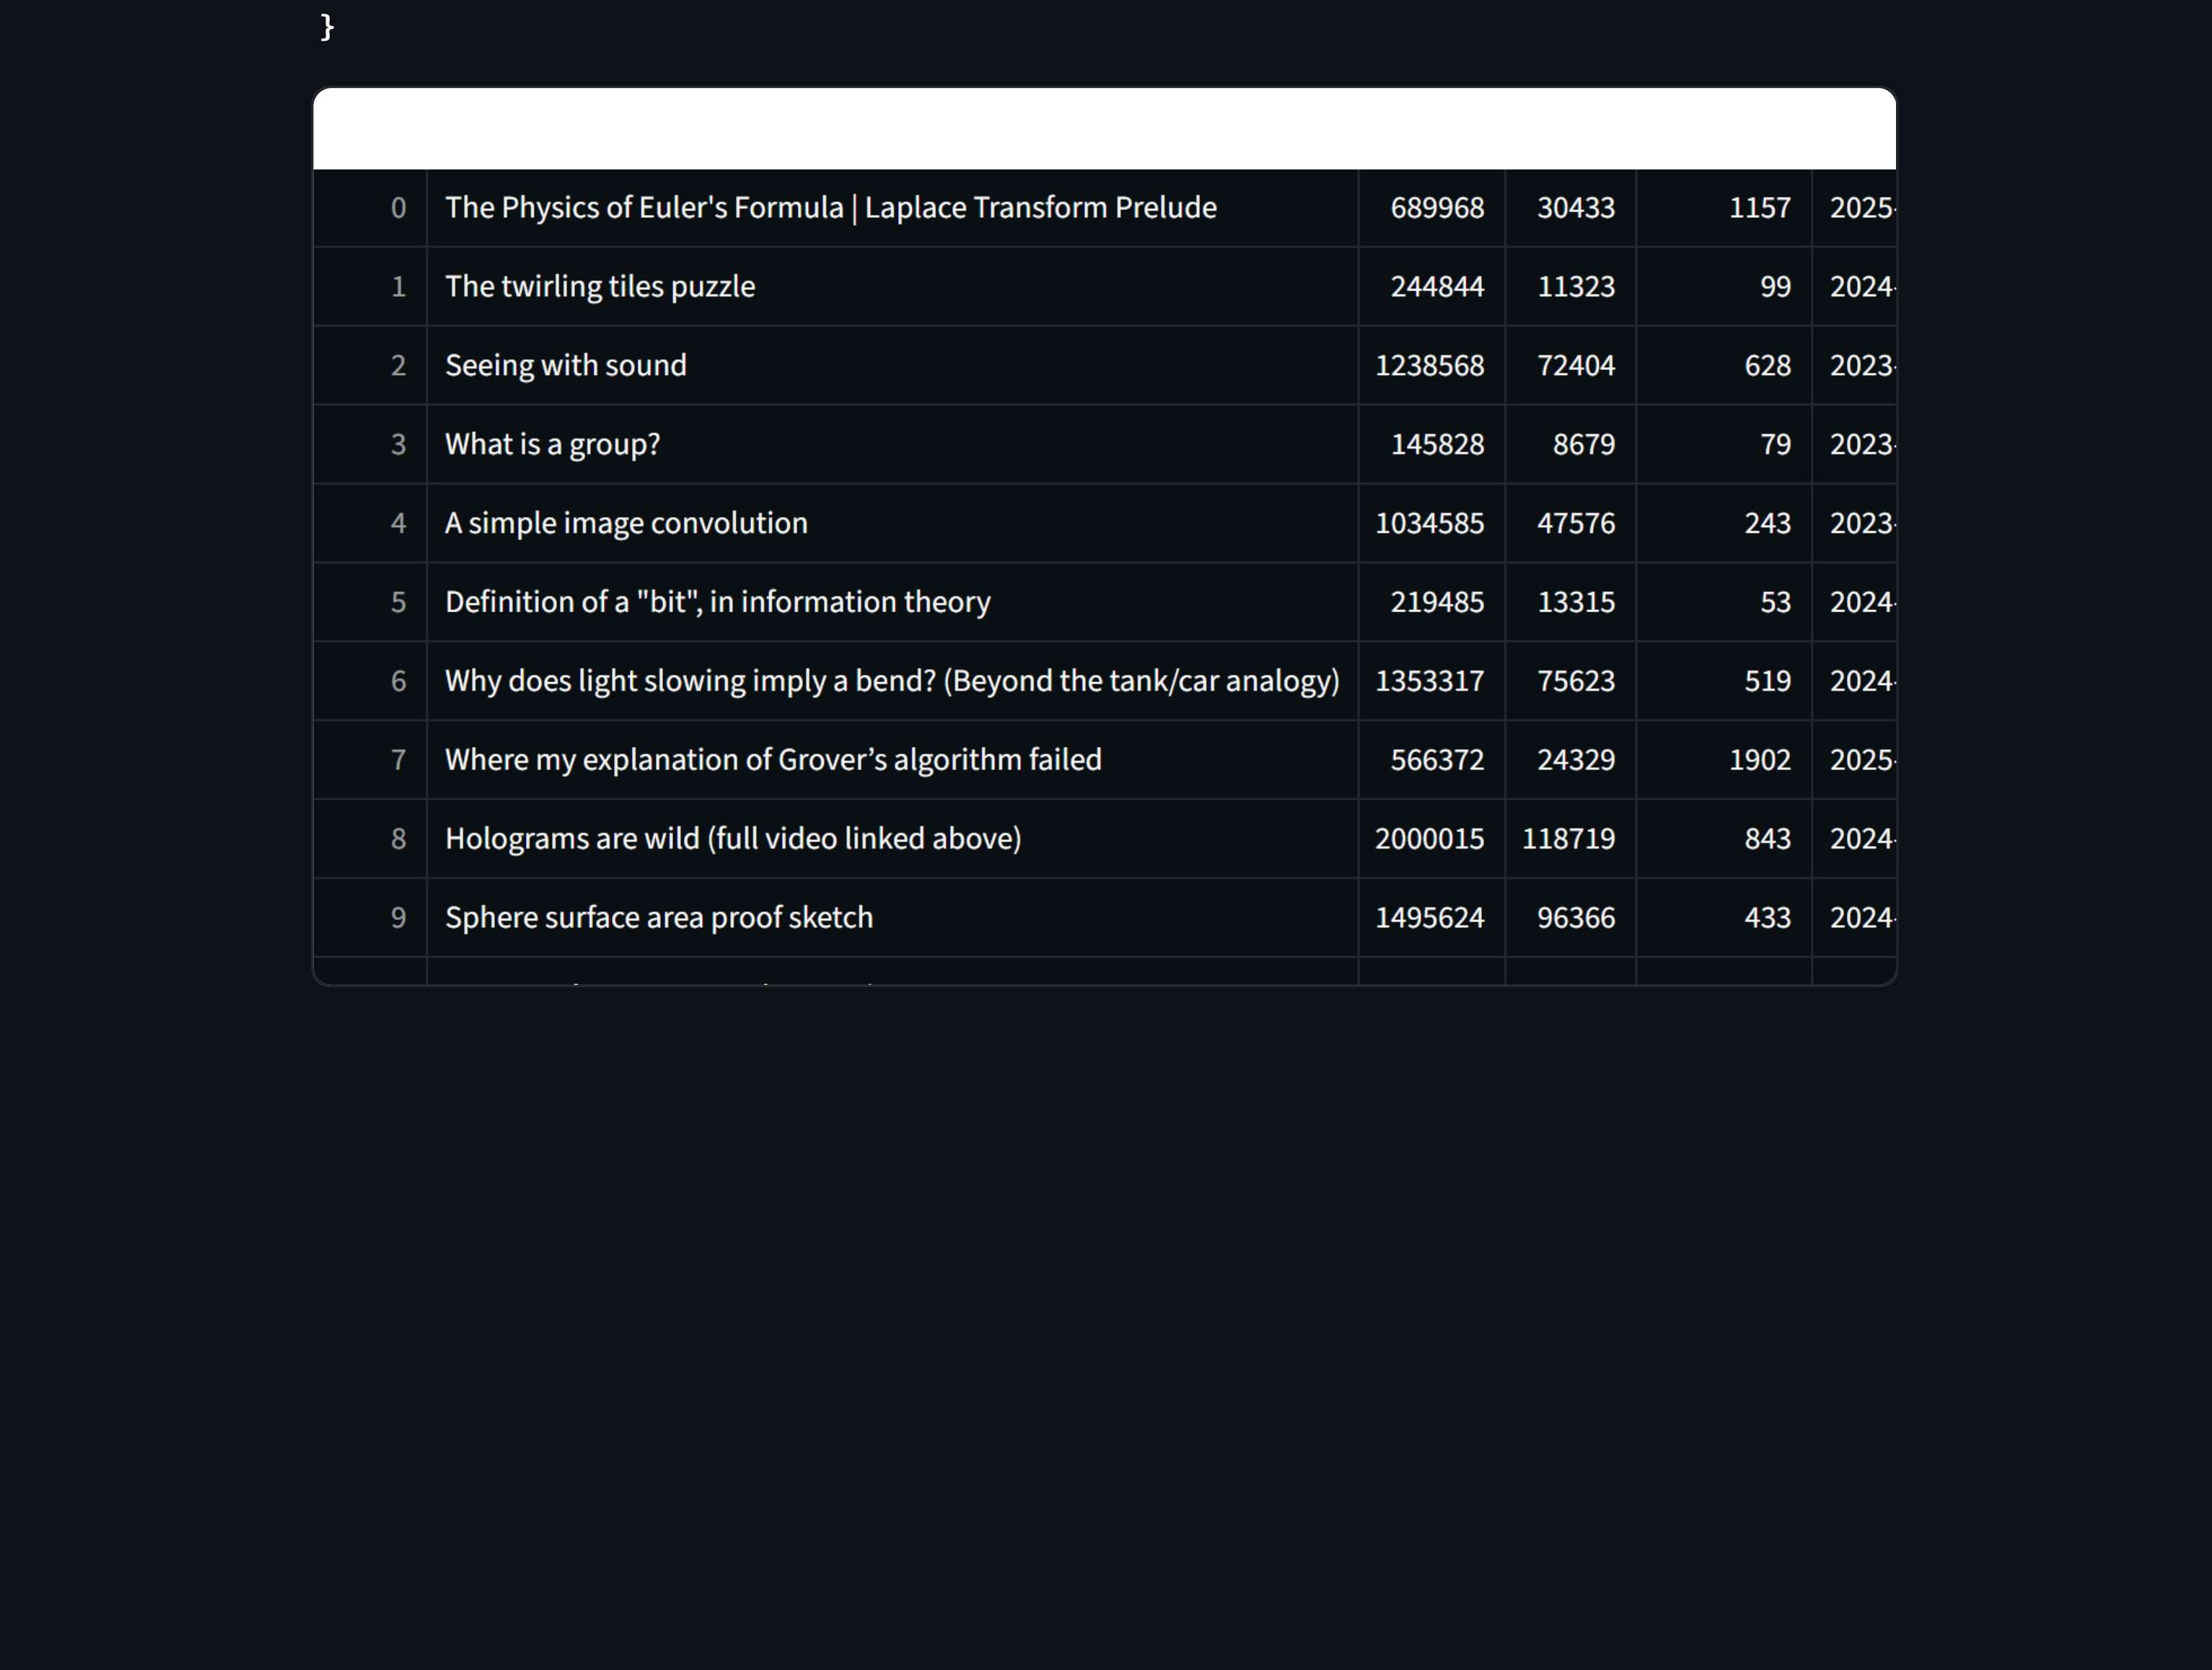





Slide 16
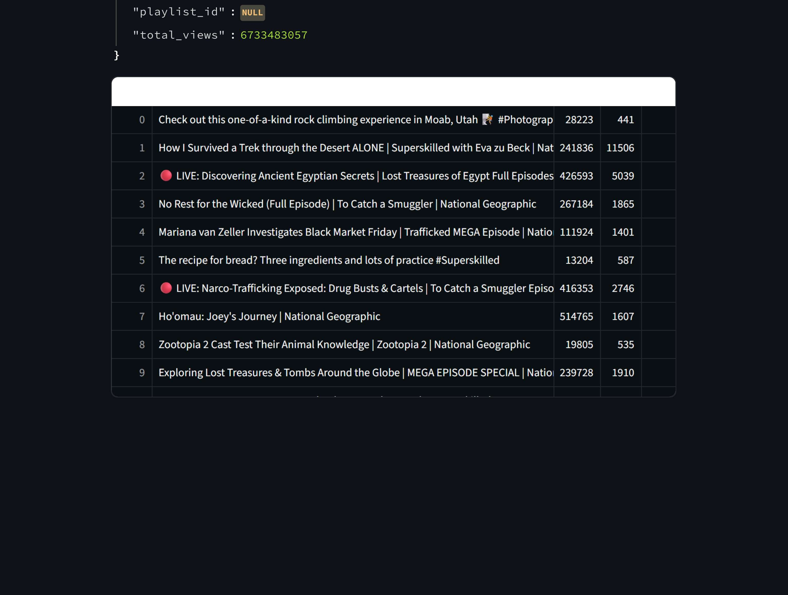








Slide 17
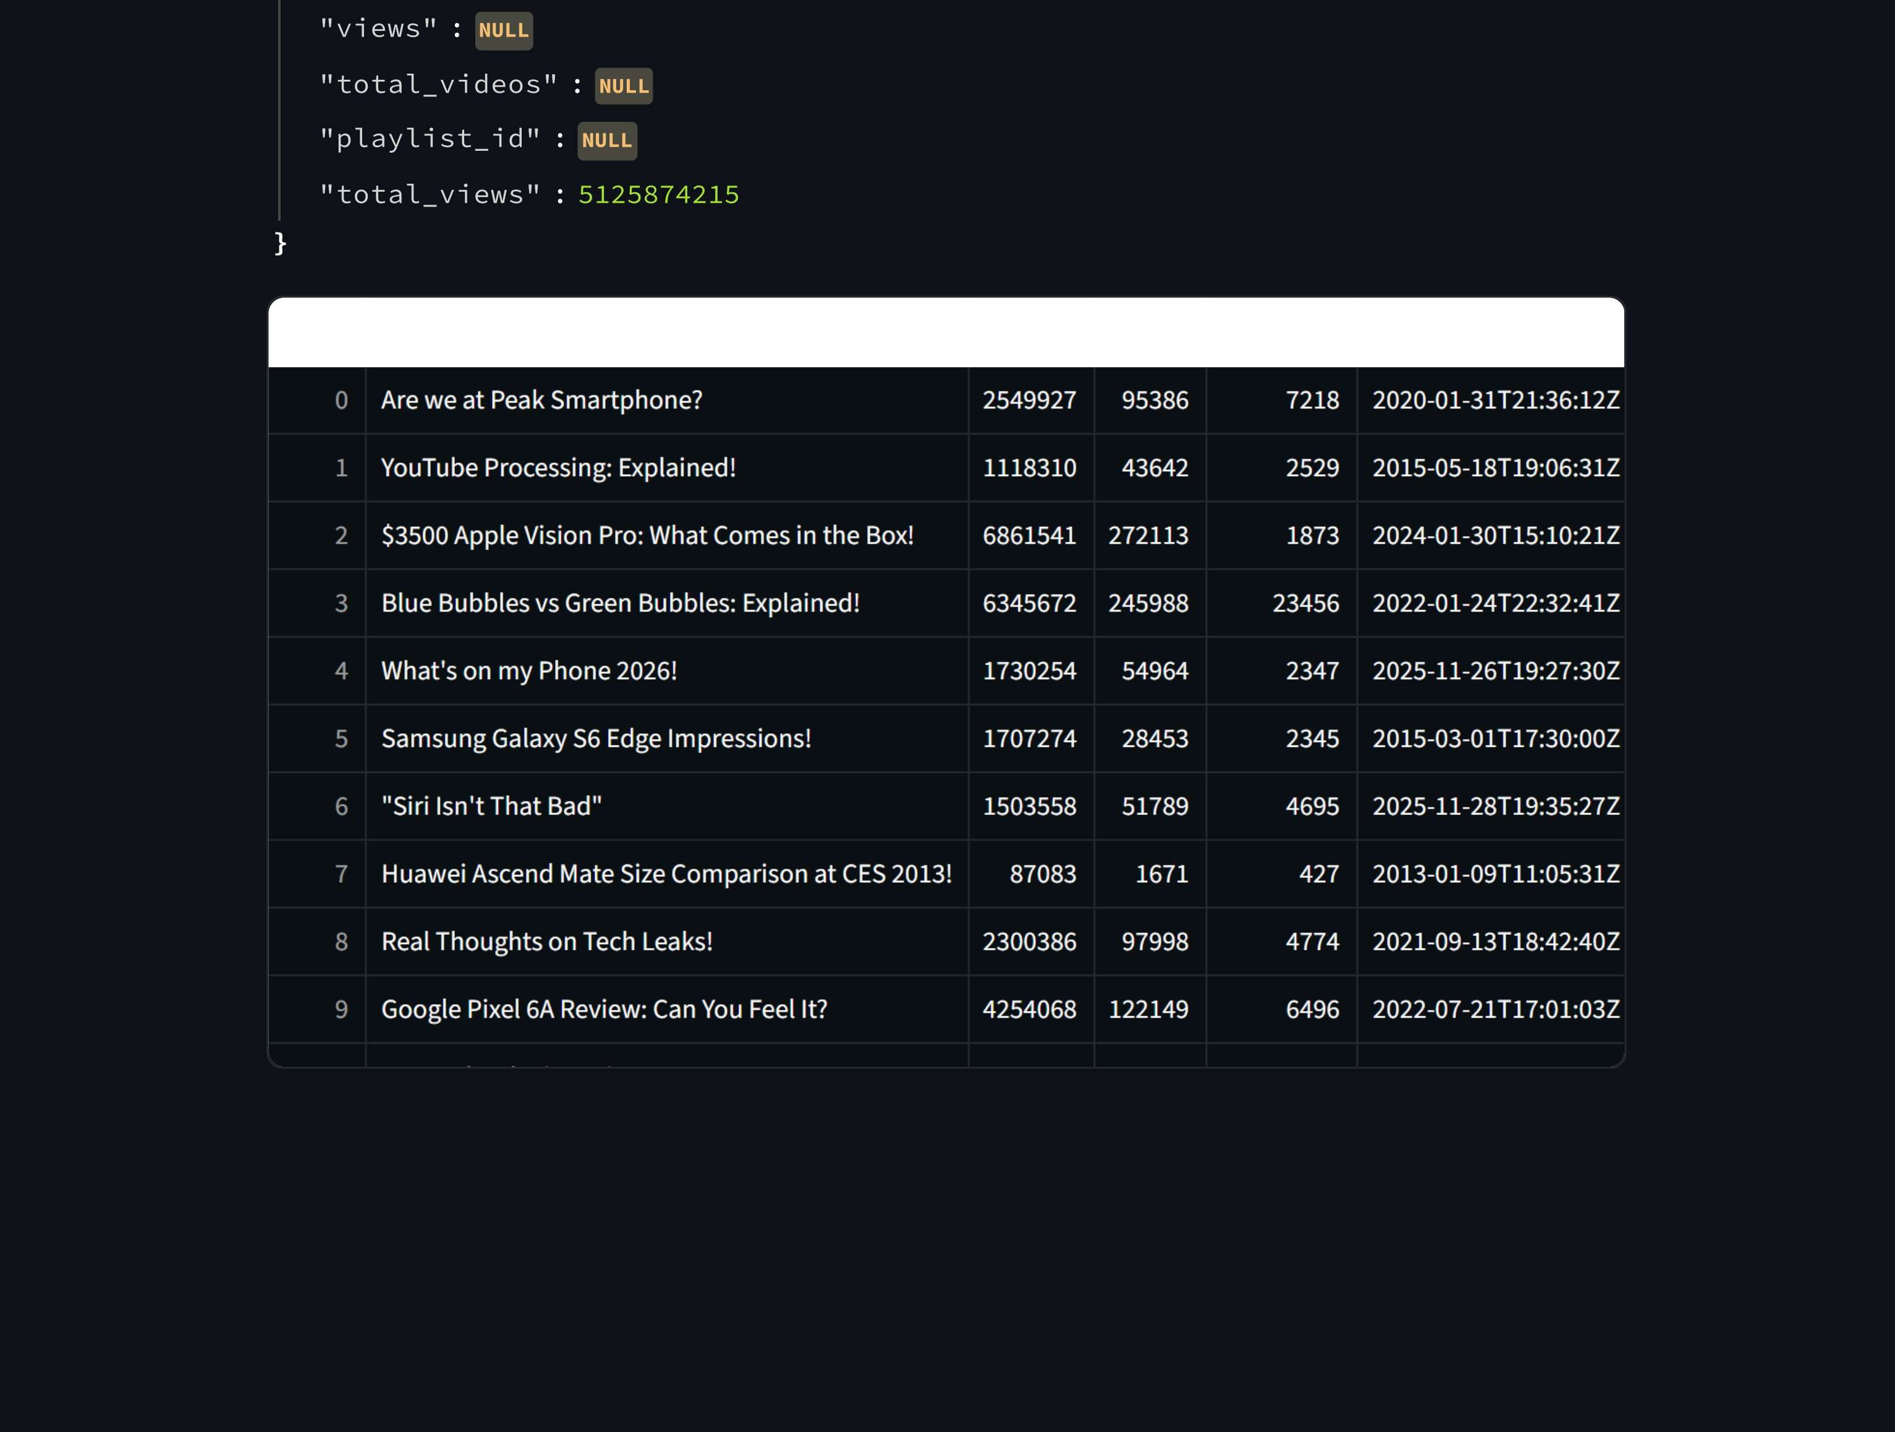




Slide 18
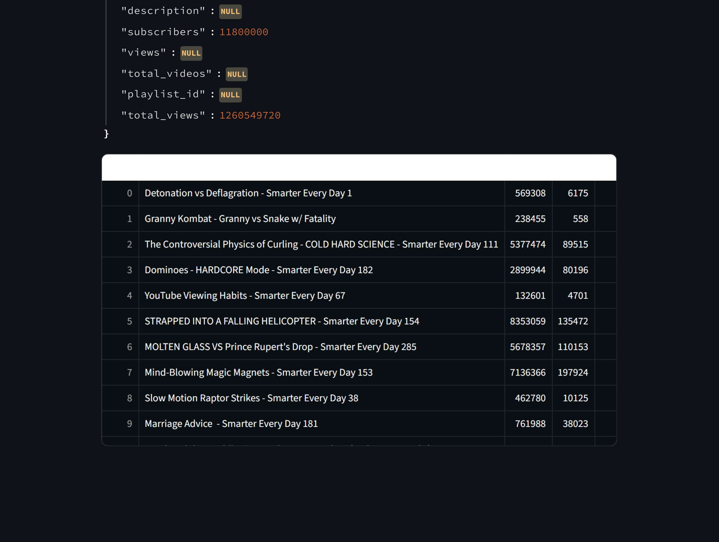


Slide 19
"c ha n n e1 _ n am e " : "L nus Tc c iJ T î ps "
"d E'S C r ń p t ń o n " : NULL
"s u bs c r ń be r s" :
'' V 1 QW S '' ' NUL L
"to t a I v ń de o s " : NULL
"p 1 a y I ń s I _ ś d " NULL
"to t aI v á ews " : 91199Ô4394
title views !likes com i
0 That Isn't Me 970513 46771
I The Honey Lawsuit Was Dismissed - WAN Show November 28, 2025 330595 6294
2 Stop Wasting Money on Premium Monitors 921261 30477
3 The Most IMMERSIVE Setup I've EVER Seen - LED Wall Display Volume with Pixomond‹ 1232021 54218
4 How To Spot an AI Image 1003204 27150
3 The All Transparent Gaming Setup 868470 36579
I've dropped tech on purpose two times 155817 4769
7 There's No Reason To Buy An iPhone - WAN Show November 21, 2025 432543 7077
S I Watched This Movie on 10 Different Formats 843806 33649
3 We made a Transparent PC 422461 12567

Slide 20




Slide 21
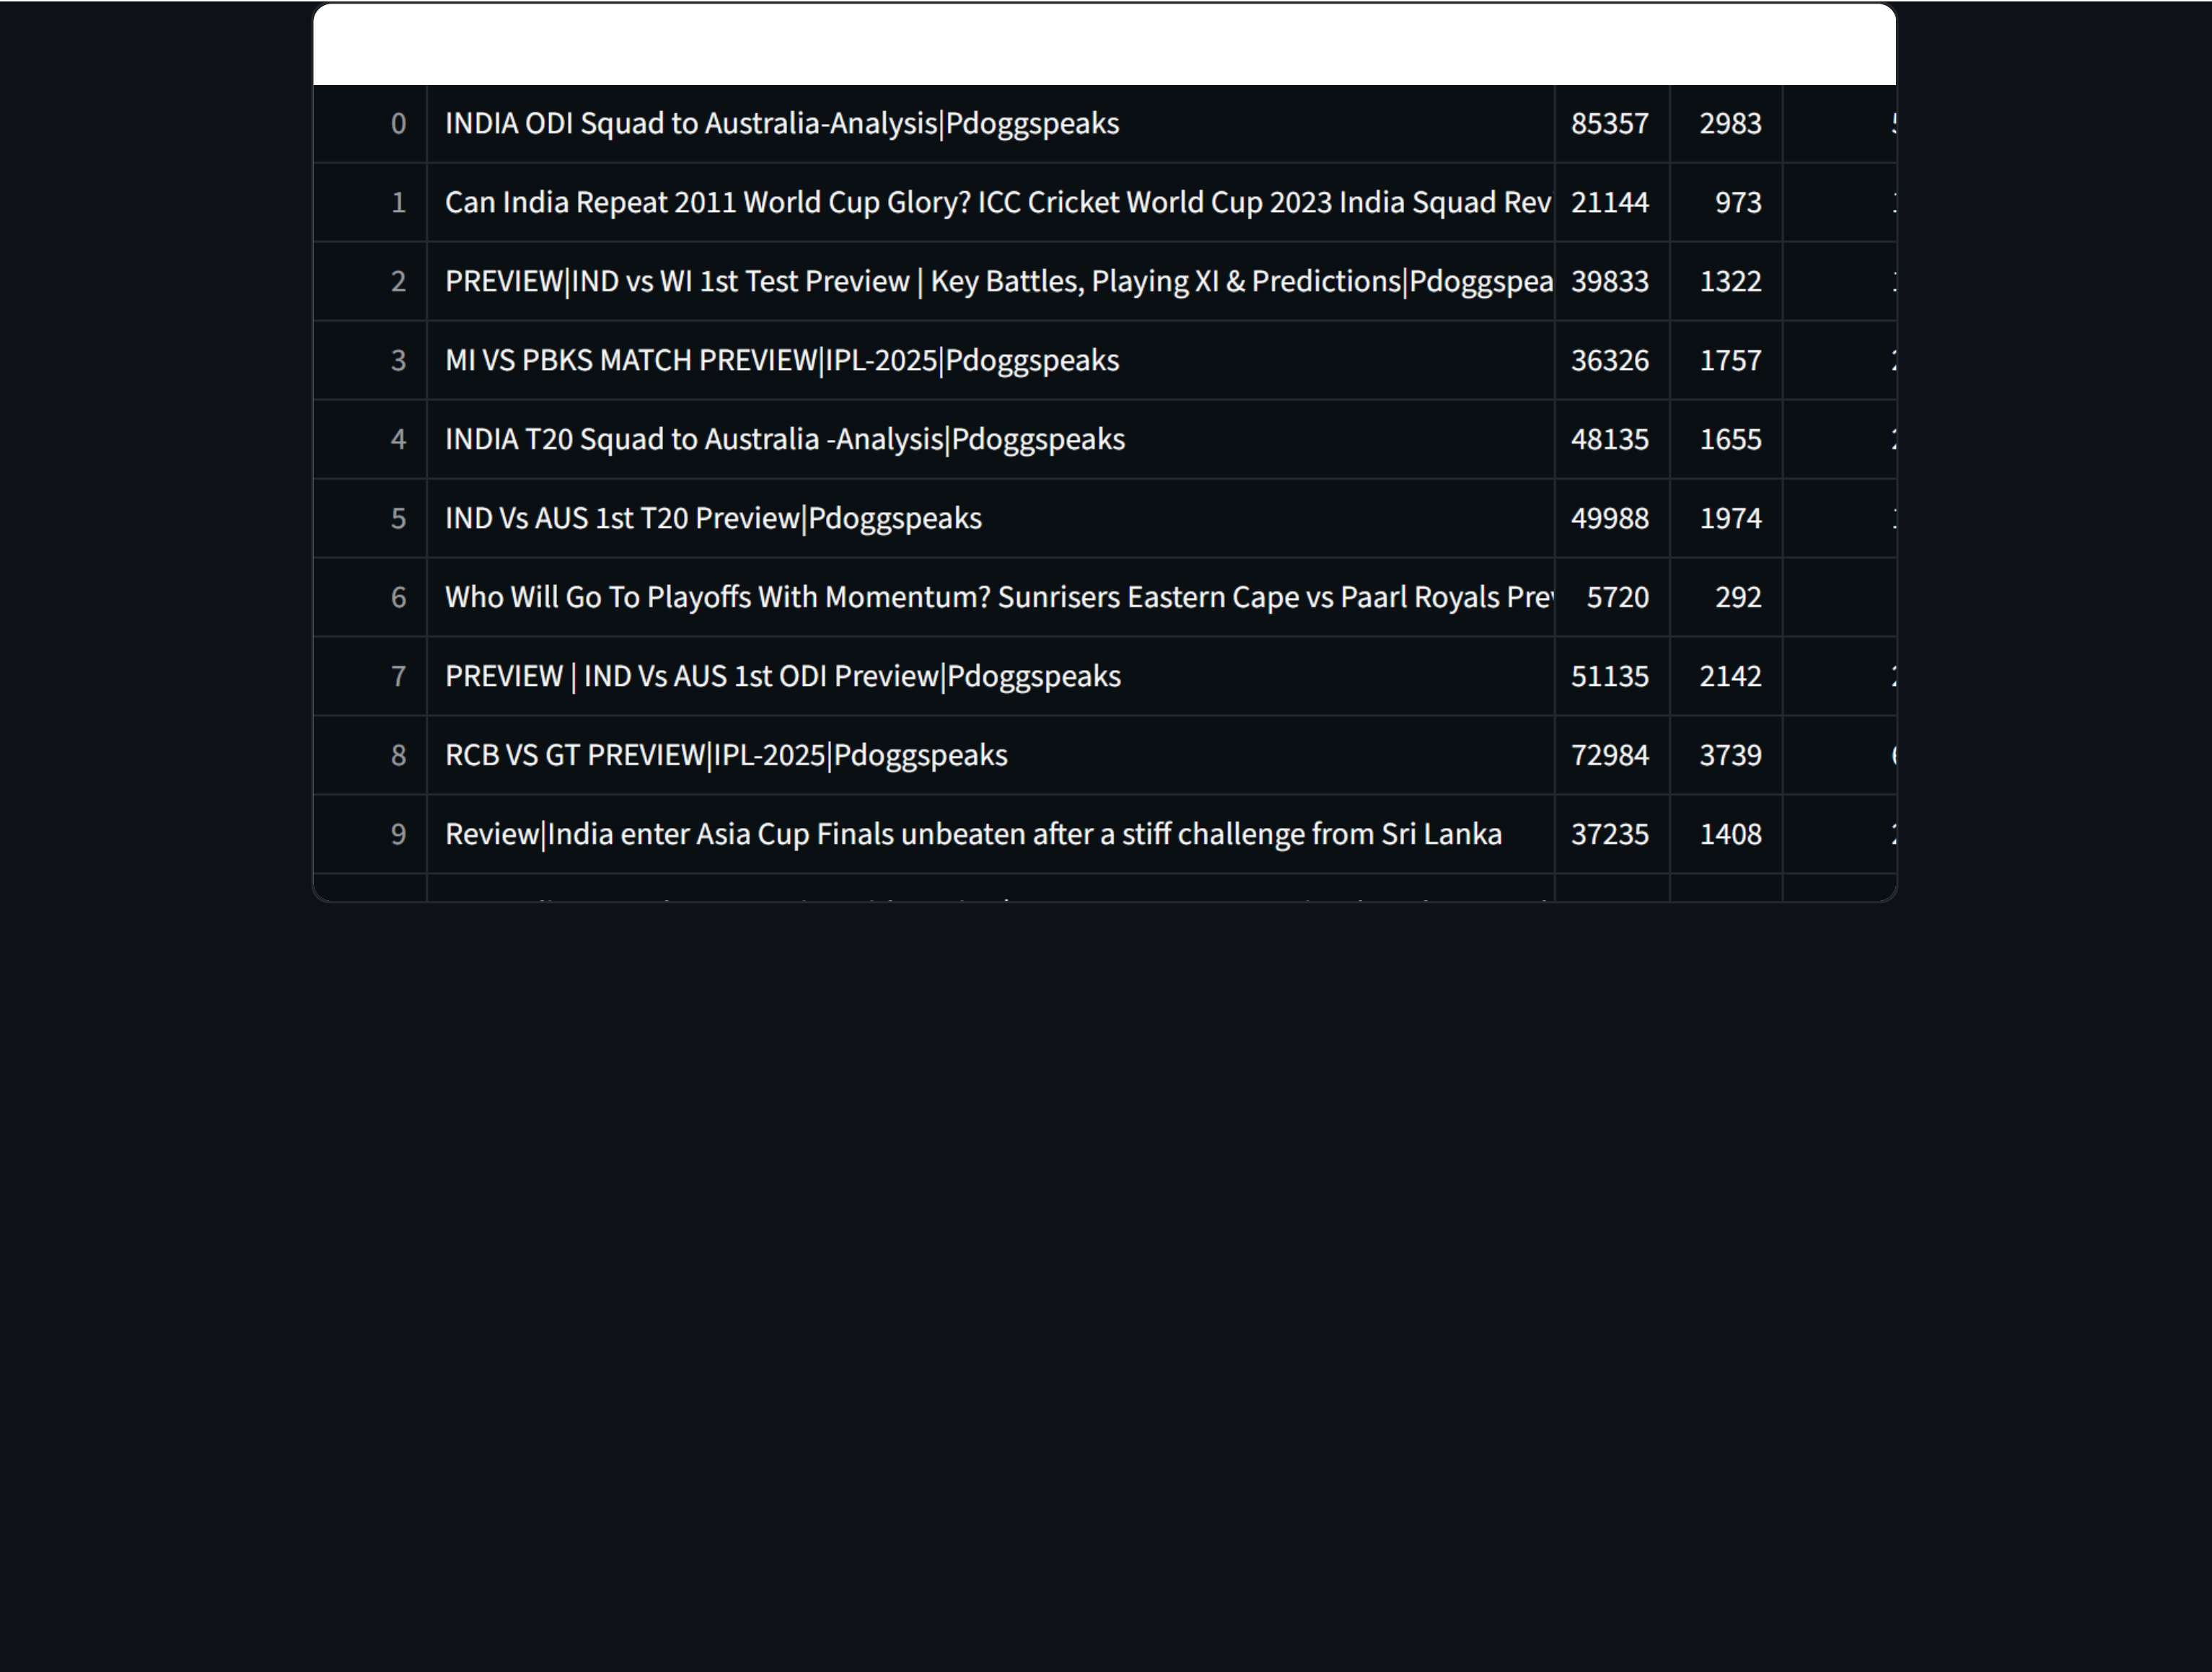








Slide 22







Slide 24
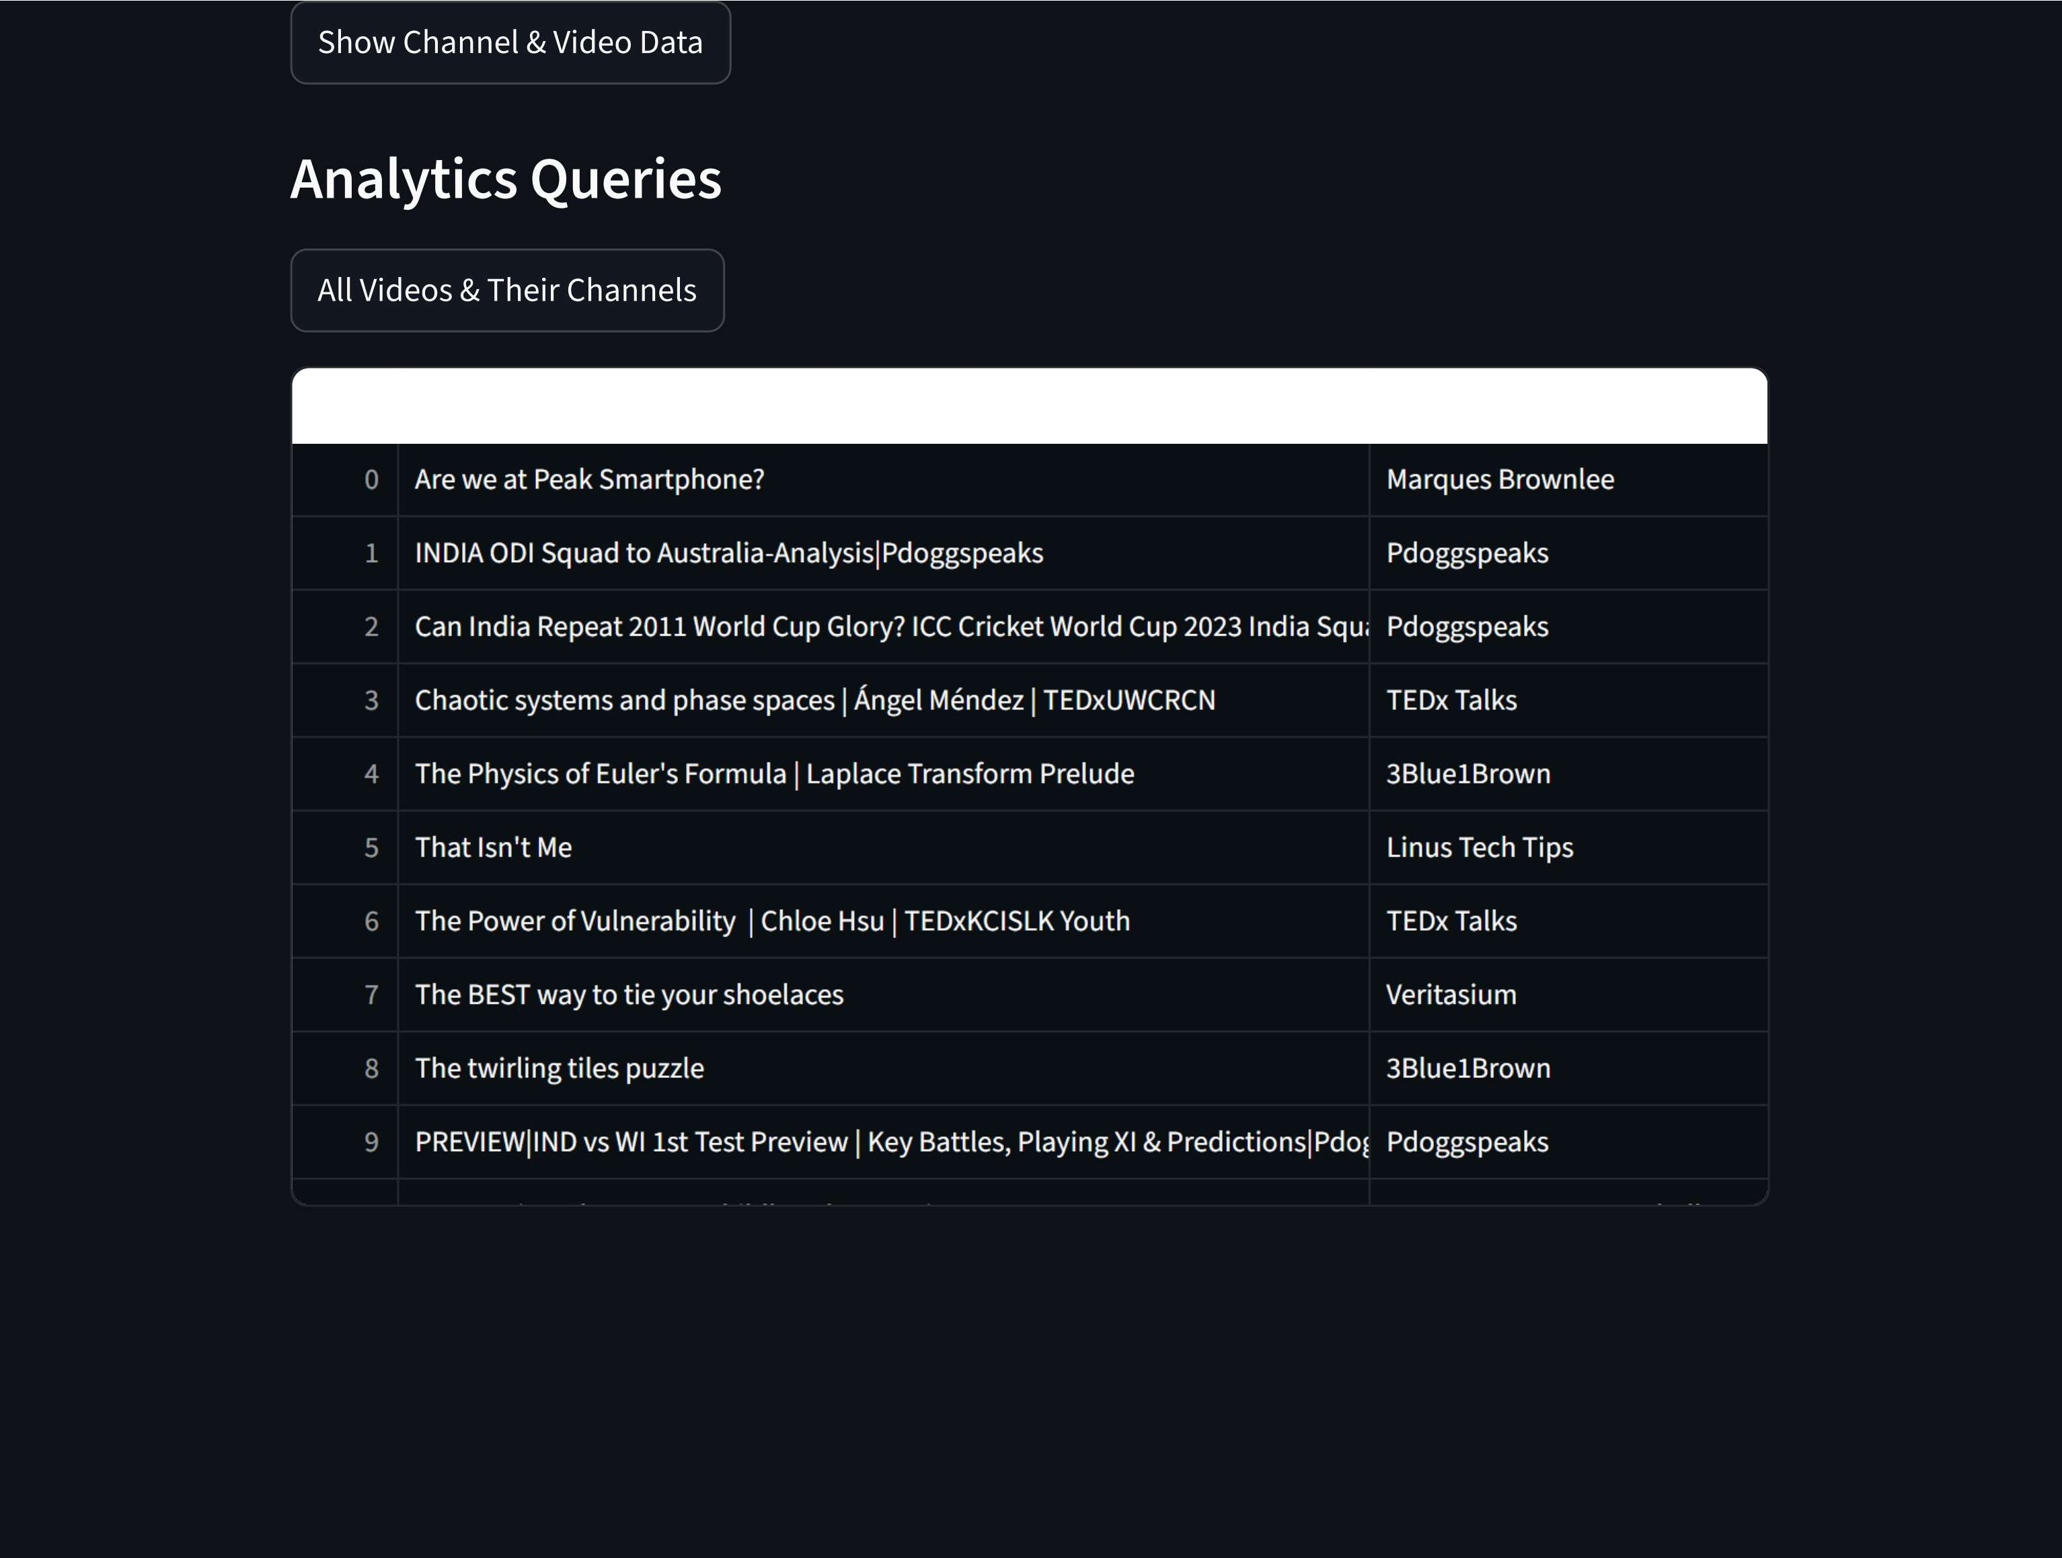



Slide 25








Slide 27
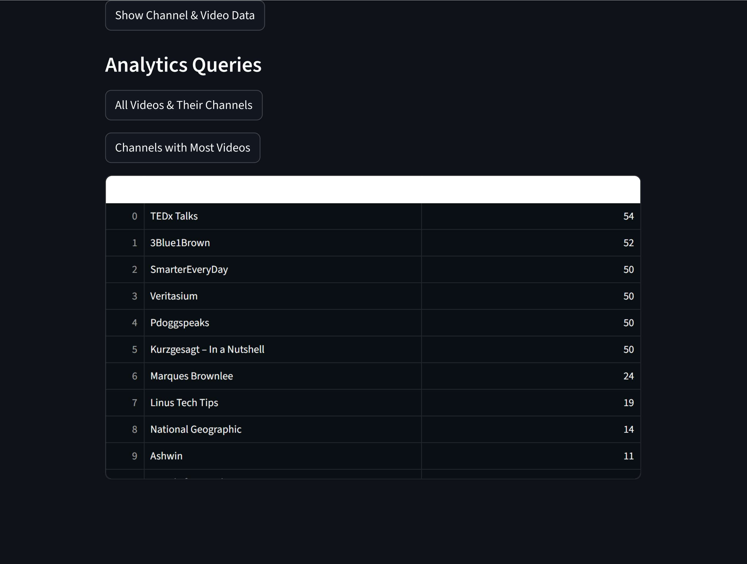

Slide 30
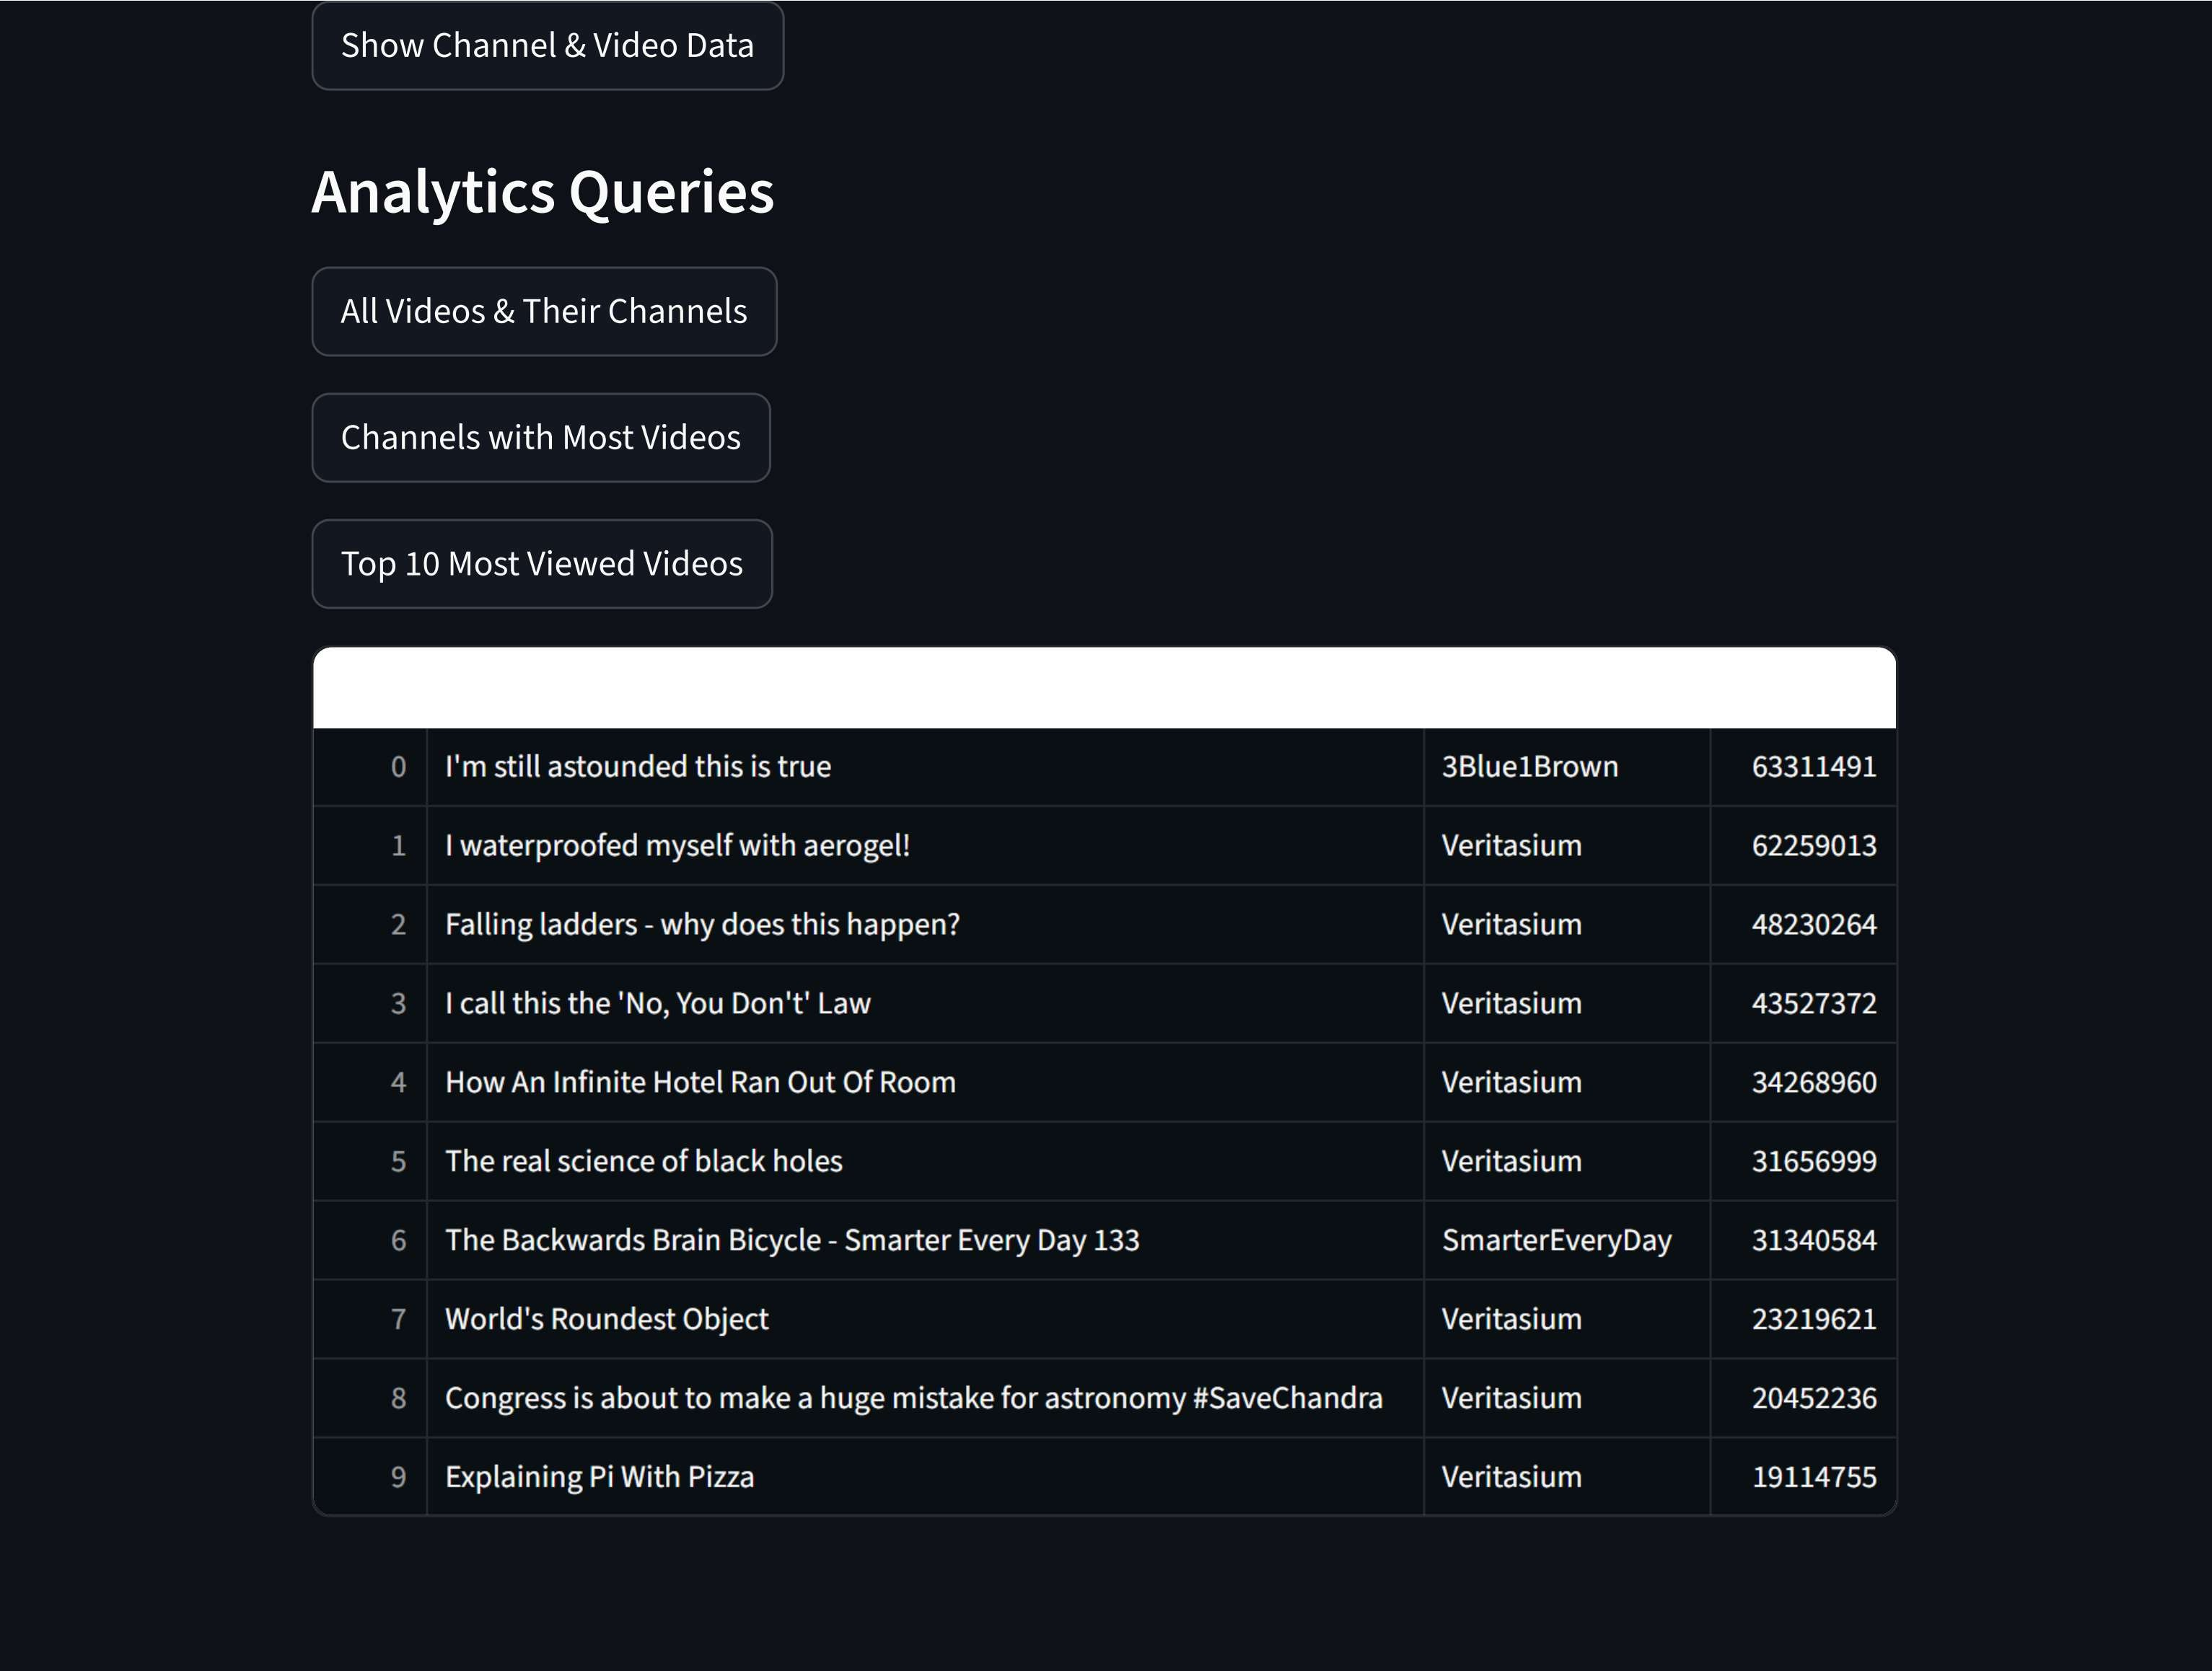


Slide 31


Slide 34
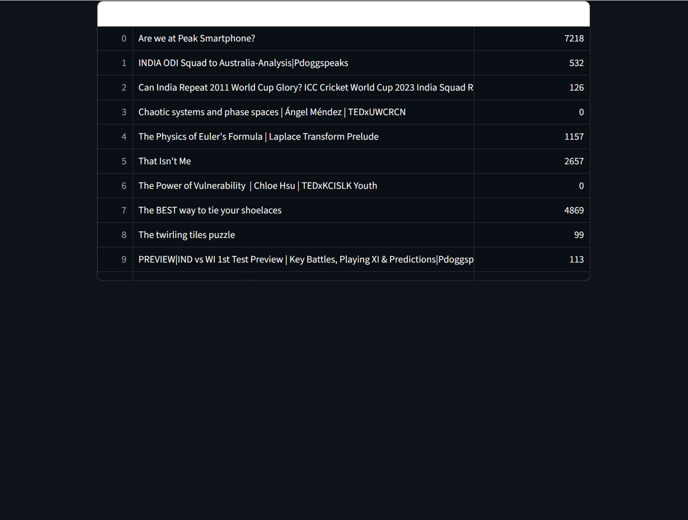






Slide 35


Slide 38
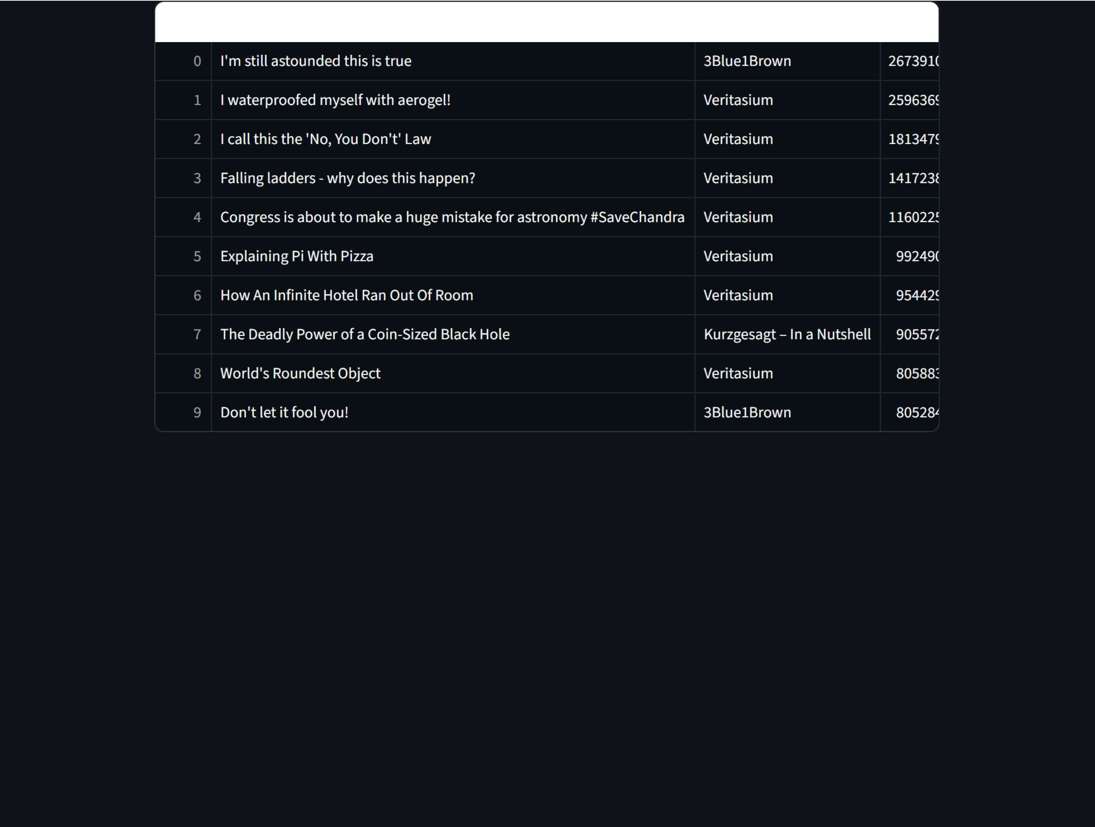






Slide 42






Slide 46
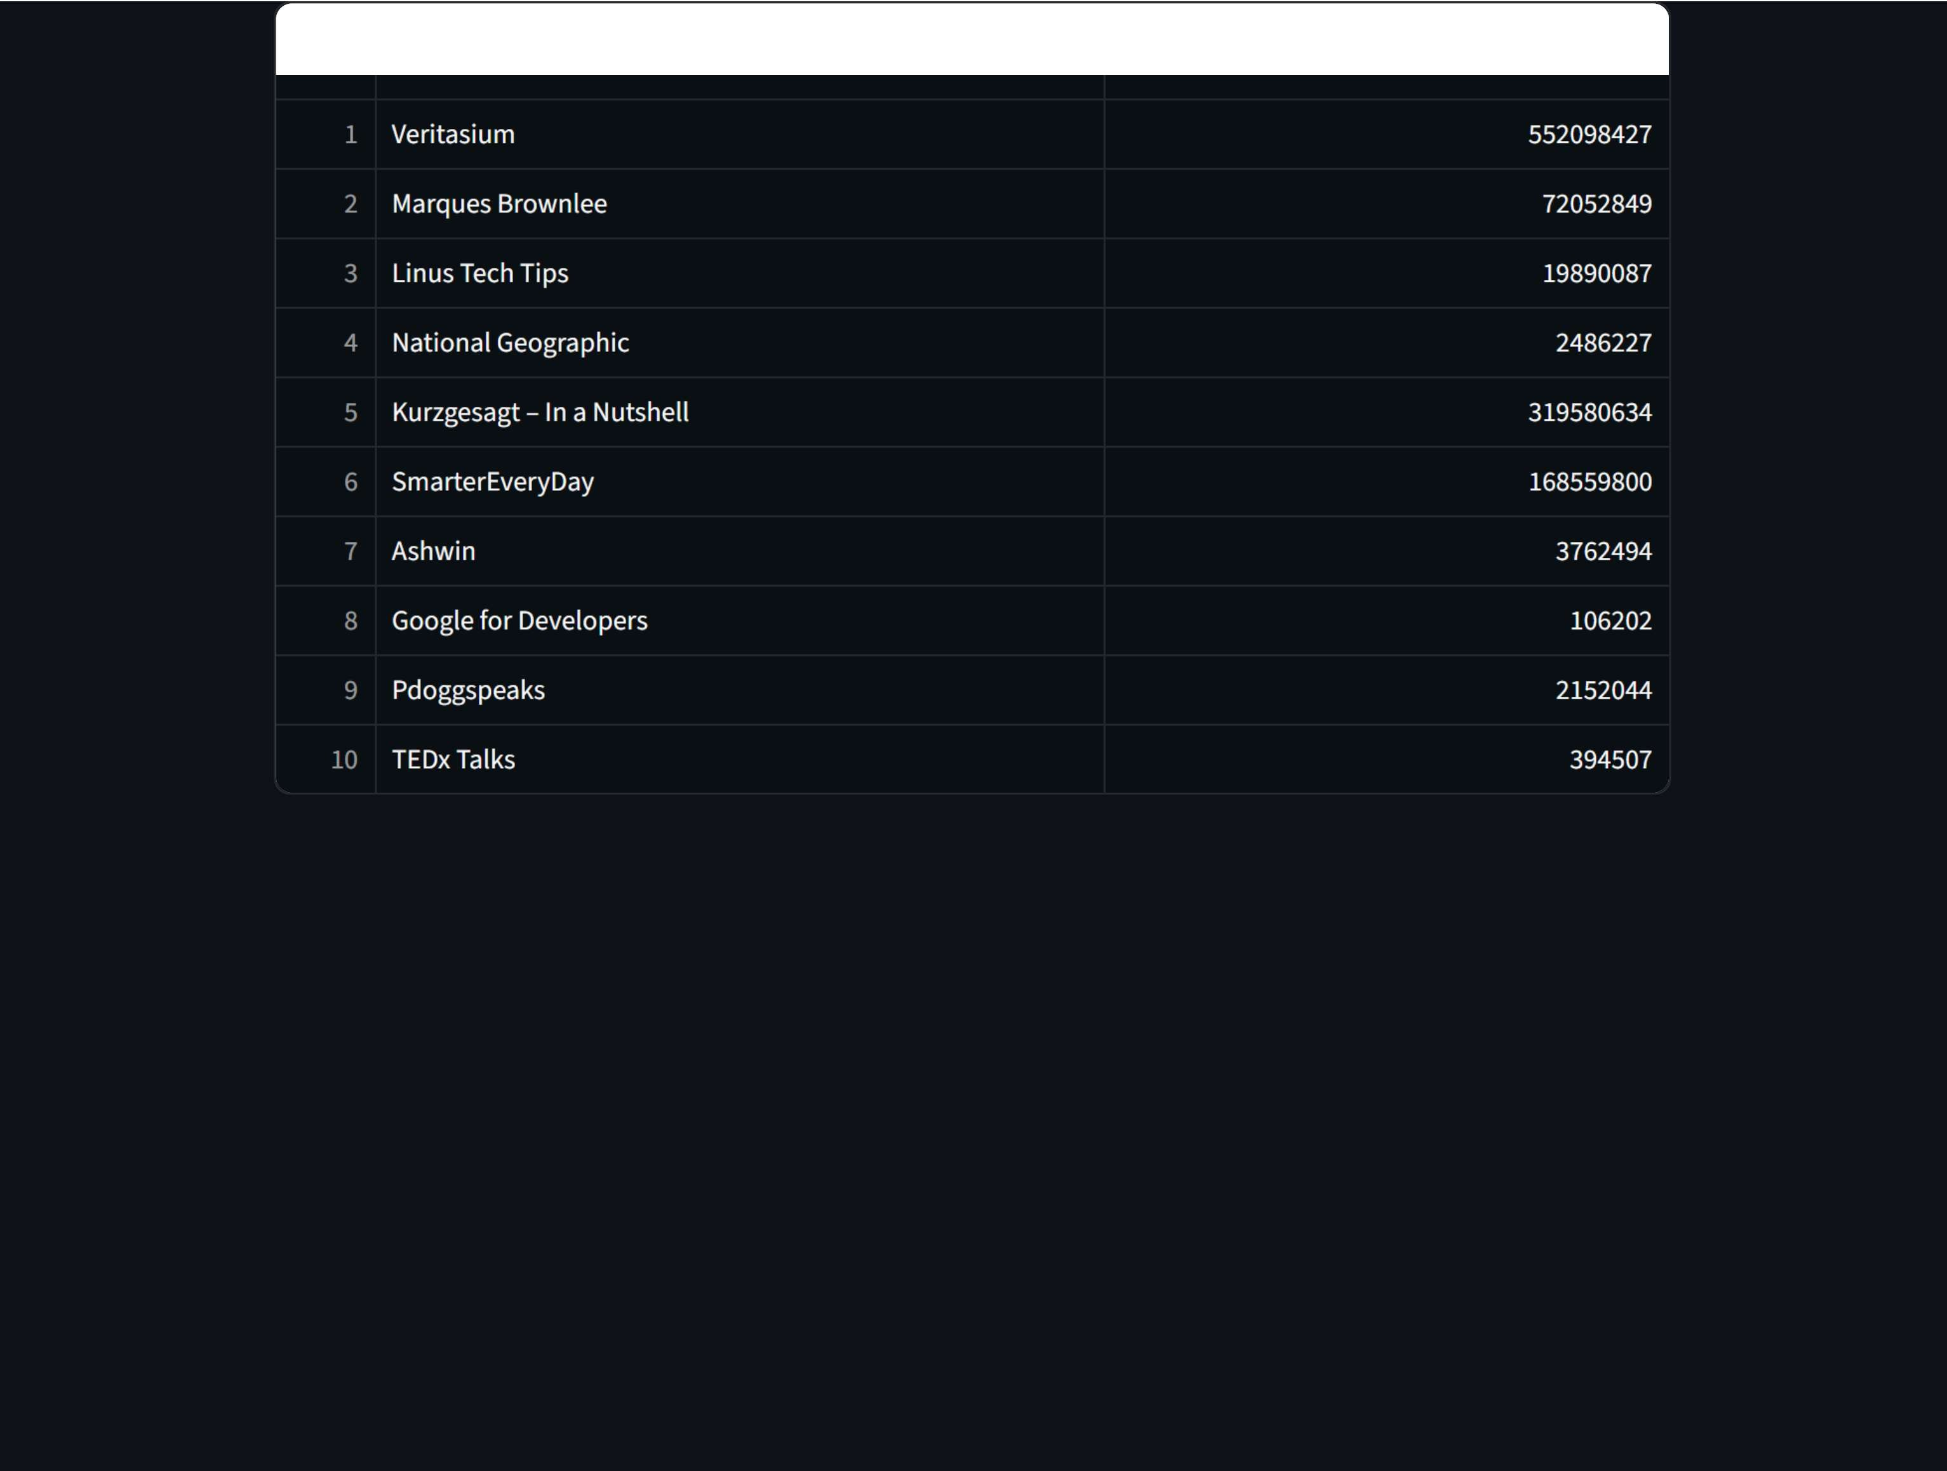





Slide 48
Analytics Queries
Show Channel & Video Data
All Videos & Their Channels
Channels with Most Videos
Top 10 Most Viewed Videos
Comments per Video
Videos with Highest Likes
Total Likes per Video
Total Views per Channel
Channels with Videos in 2022
Marques Brownlee
Veritasium
SmarterEveryDay

Slide 49



Slide 52
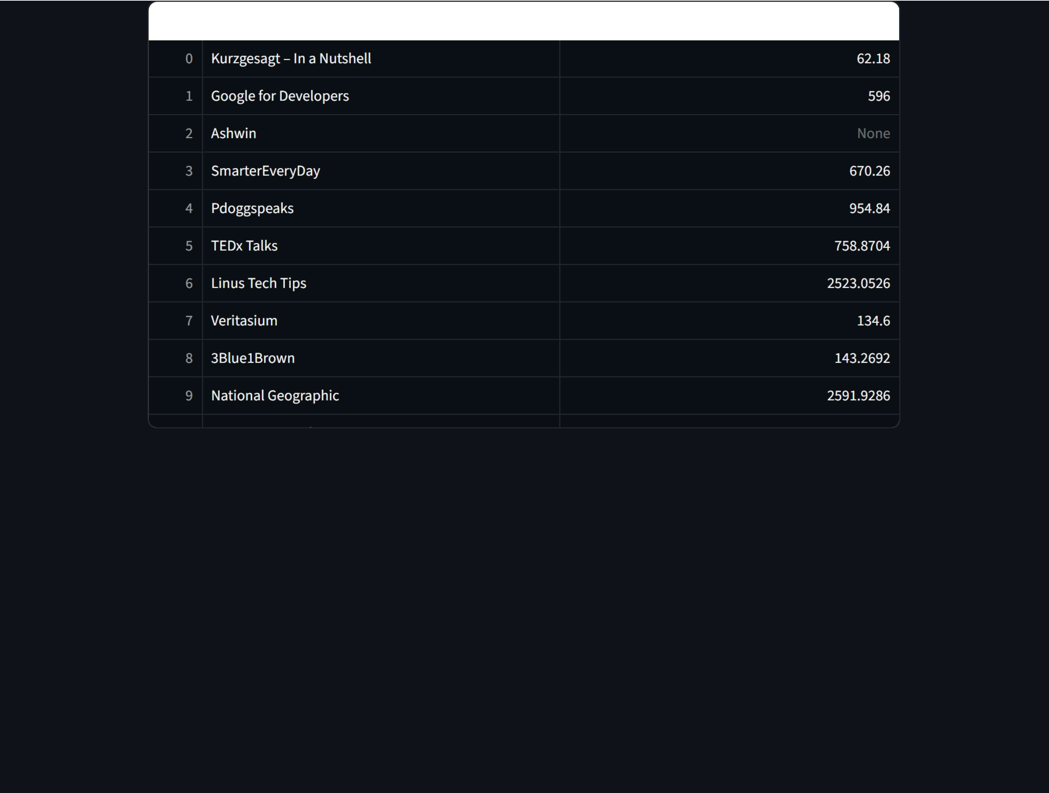


Slide 55
video_name channel_name cor
0 How An Infinite Hotel Ran Out Of Room Veritasium
I Falling ladders - why does this happen? Veritasium
2 Congress is about to make a huge mistake for astronomy #SaveChandra Veritasium
3 How Does A Carburetor Work? | Transparent Carburetor at 28,546 fps Slow Mo - Smart SmarterEveryDay
The Backwards Brain Bicycle - Smarter Every Day 133 SmarterEveryDay
Blue Bubbles vs Green Bubbles: Explained! Marques Brownlee
c I waterproofed myself with aerogel! Veritasium
The real science of black holes Veritasium
Explaining Pi With Pizza Veritasium
How Do Nuclear Submarines Make Oxygen?- Smarter Every Day 251 SmarterEveryDay

